Slide 1

Test Automation Bootcamp: From Zero to Hero

Slide 2
1. Testing Overview

Slide 3
2. Automation Testing

Slide 4
What is Automation Test?

Slide 5
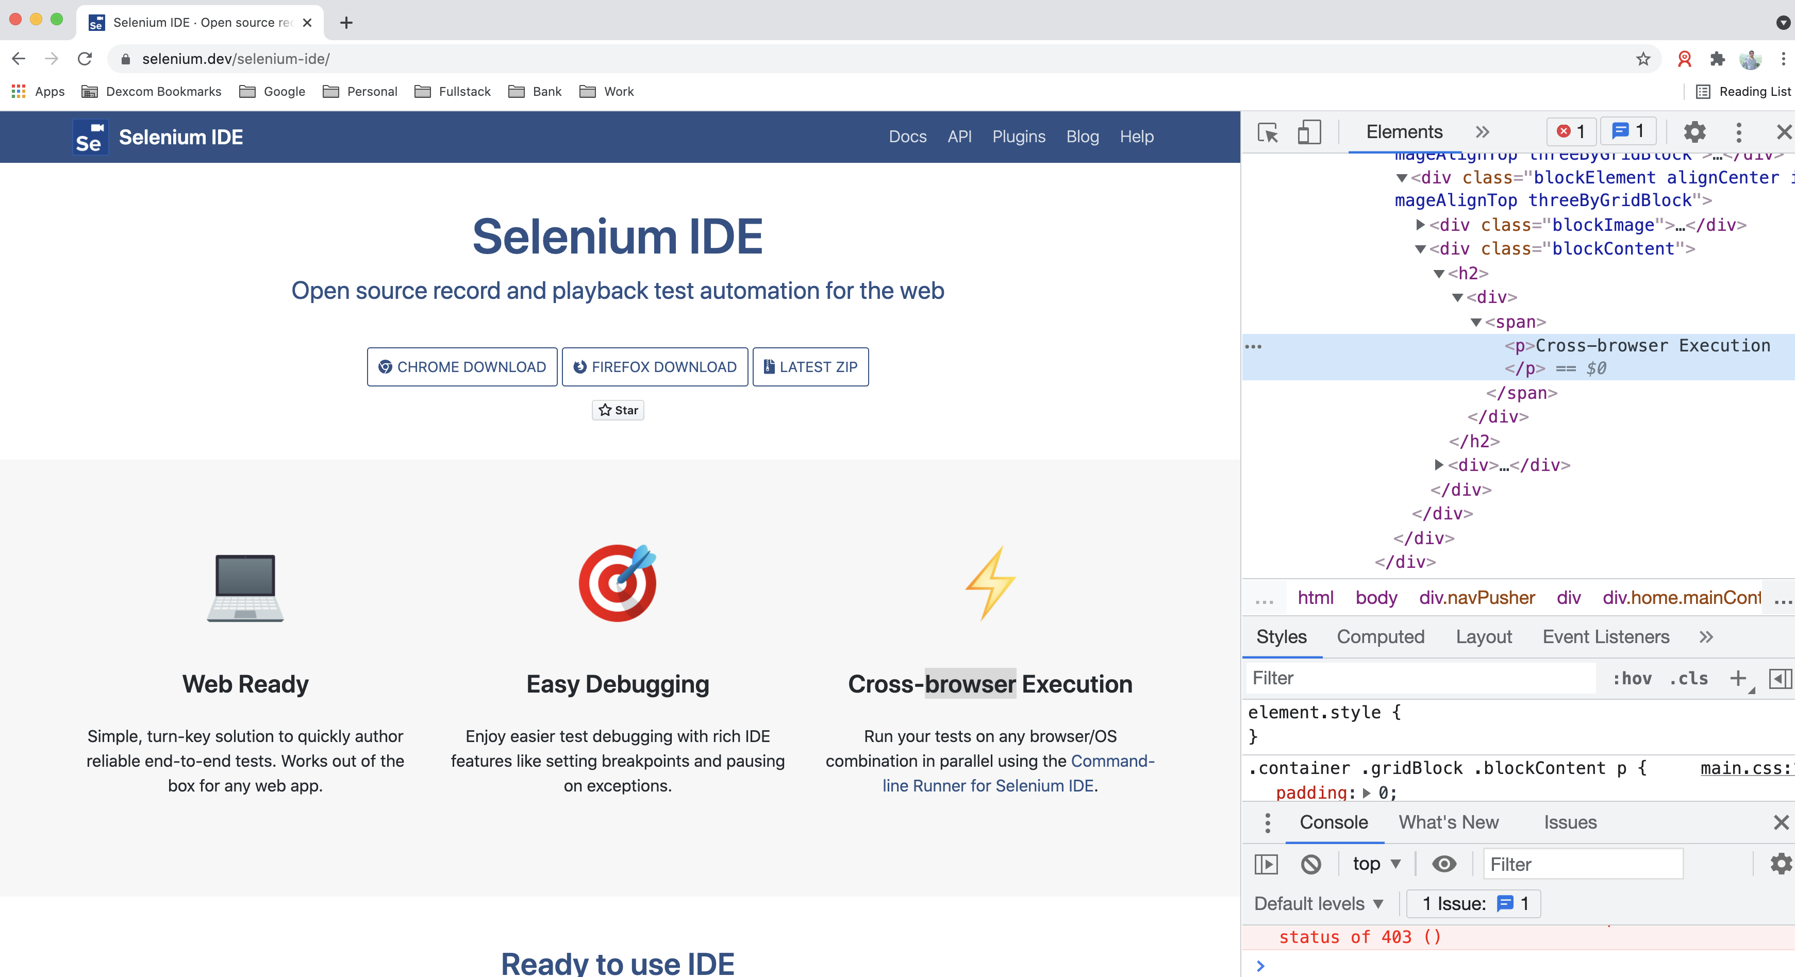
What is Automation Test?
Automation Test
Test automation is many things, we will define test automation as the automatic execution of functional tests, designed at least in some ways to simulate a human being executing manual tests.

Slide 6
Advantages and disadvantages of Automation Test?
Advantages
Performing some tests that cannot be performed at all (or easily) manually
Reducing the time needed for test execution
Increasing the frequency that some tests can be run
Reducing mistakes made by bored or distracted manual testers
Executing tests outside of normal business hours
Increasing confidence in the build
Disadvantages
Delays, costs, and mistakes associated with testers as they learn new technologies
In worst cases, complexity may become overwhelming
Considerable maintenance of tools, environments, and test assets required
The pesticide paradox is increased when automation is used since exactly the same test is run each time
Without clever programming in the automated tests, tools are literal minded and stupid;testers are not

Slide 7
3. Selenium

Slide 8
Selenium Architecture Components
Selenium Facts
Selenium is an Open-Source Automation Tool
It’s exclusively for Web Applications
It works with different browsers: Firefox, Chrome, Safari, Internet Explorer, Edge
Can run in different OS: Windows, Linux, Mac OS
Can use multiple programming languages: Java, C#, Python, JavaScript, Ruby

Slide 9
Selenium Architecture Components
Selenium IDE
It is an add-on to Chrome and Firefox web browsers, its main function is recording and playing back user actions on web pages; the recorded scripts can be saved to disk as HTML tables or exported to several different programming languages.
Selenium WebDriver *
It is mainly a framework allowing test scripts to control web browsers, enables test automators to combine WebDriver’s ability to control web browsers with the power of general programming languages.

Slide 10
Selenium Architecture Components
Selenium Grid
It enables running test scripts across multiple machines with different configurations. It allows distributed and simultaneous execution of test cases. It can be configured to use many physical or virtual machines with different combinations of operating systems and versions of web browsers.
Selenium Standalone Server
This tool is written in Java and is delivered as a jar file that implements hubs and nodes functions for Selenium Grid. This tool needs to be started separately (outside of test scripts) and configured properly to play its role in test environment.

Slide 11
4. Web Automation

Slide 12
5. Verifications and Assertions

Slide 13
6. Appium

